Slide 1
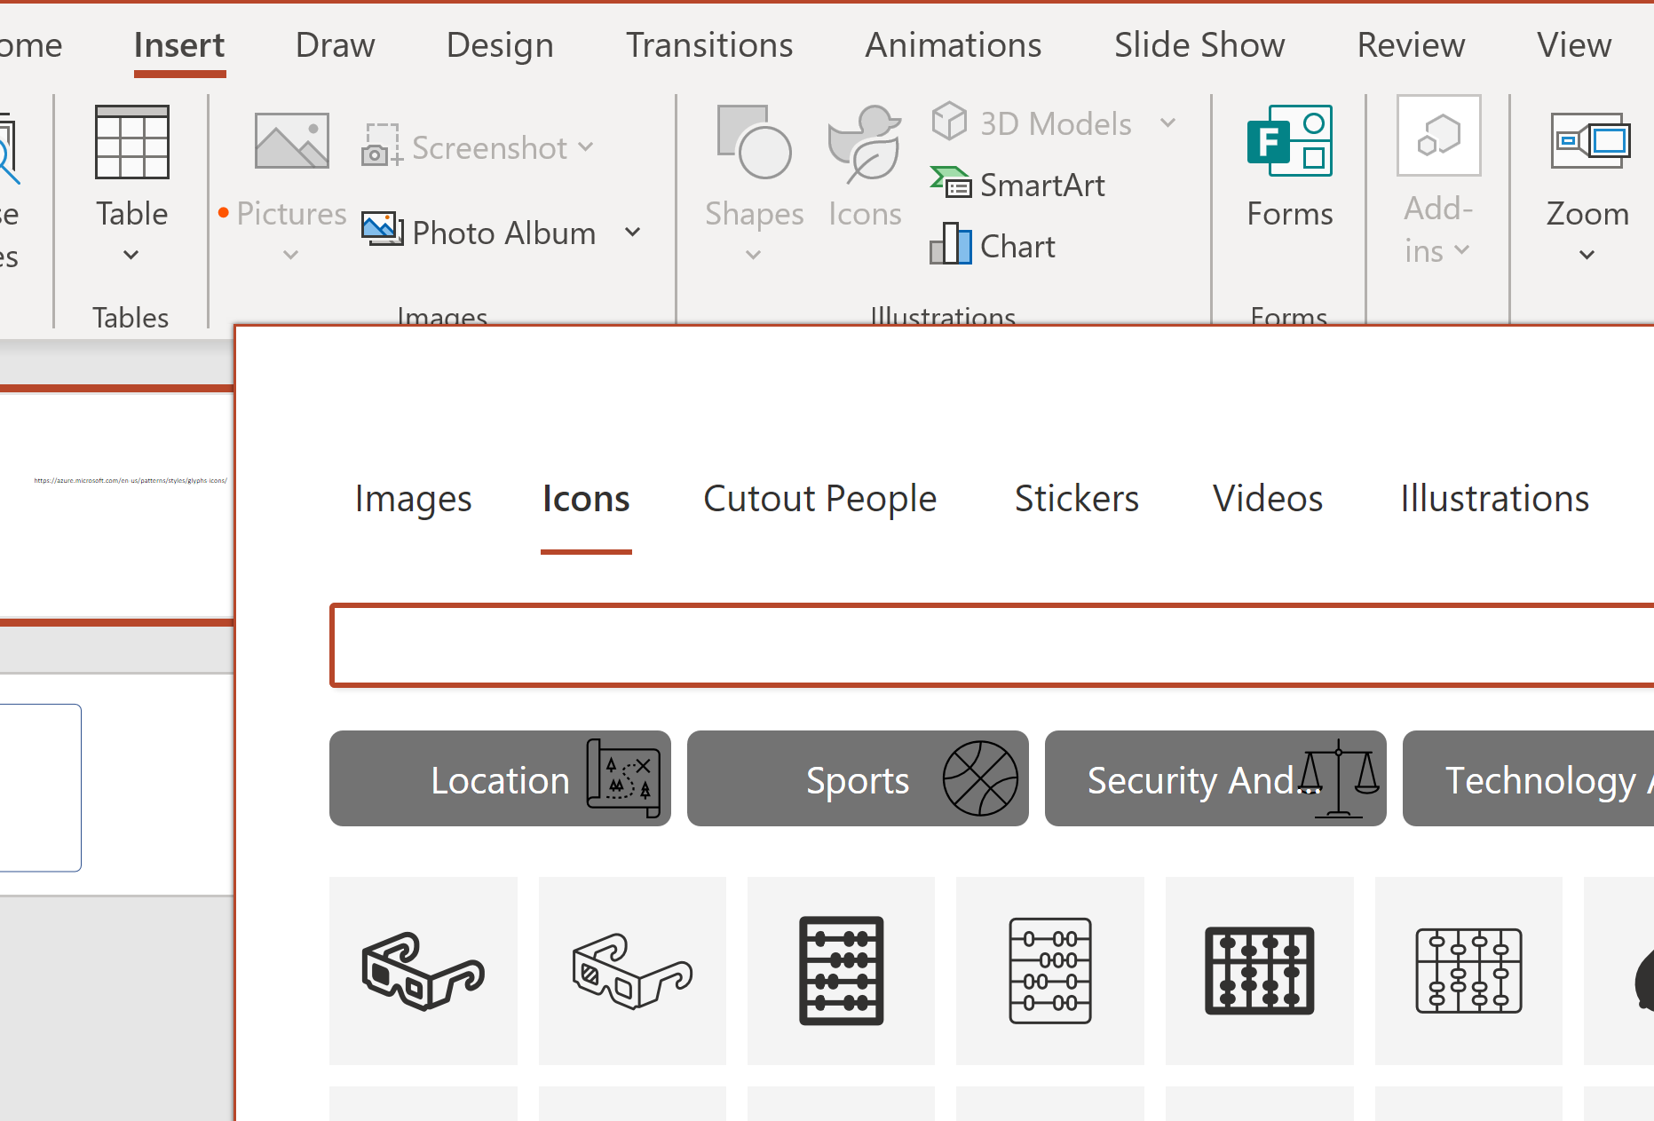
Image Resources
https://azure.microsoft.com/en-us/patterns/styles/glyphs-icons/
https://www.datalineo.com/gallery-smart-metric-guide

Slide 2






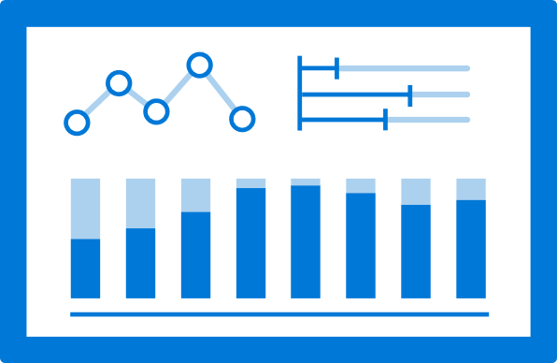



Frequently Icons
https://www.datalineo.com/gallery-smart-metric-guide

Slide 3

The Delivery Time metrics are based on tracking data stored in our logistics database which is updated in real-time. Shipment SLA Targets are managed in Dynamics CRM.
Delivery Time
Live Tracking
CRM
Delivery SLAs
Shipment Data
4-hourly
● <95%
● <75%
https://www.datalineo.com/gallery-smart-metric-guide

Slide 4



The Sales Metrics are based on the Sales data downloaded from our cloud ePos system overnight and Forecast data from manually maintained Excel files.
Sales Metrics
Store Sales
Cloud ePos
Sales
Data Warehouse
Forecast Data
Nightly 12-2am
● <95%
● <75%
https://www.datalineo.com/gallery-smart-metric-guide

Slide 5

Employee Expense metrics are sourced from the SAP Finance module and merges with workday, our HR system, to report by department and SharePoint to validate approvals.
Employee Expenses
Expenses
Organisation Hierarchy
Expense
Approvals
6-Hourly
https://www.datalineo.com/gallery-smart-metric-guide

